Slide 1
Installation Guide to MATLAB and Simulink R2025a
McMaster Automotive Resource Centre (MARC)
Notes:
Matlab Installing Tutorial – another section in the same PowerPoint

Slide 2
Installation Guide to MATLAB and Simulink R2025a
Prerequisites
Must have a MathWorks Account
Computer must meet the MATLAB system requirements (Previous Releases’ requirements)
For Windows, the requirements are (For other platforms, visit Linux or macOS):
Criteria | Recommended | Minimum
OS | Windows 10/11 (version 22H2 or higher) Windows Server 2022/2025
Processor | Intel or AMD x86-64 processor with 4 or more cores AVX2 instruction set support | Intel or AMD x86-64 processor with 2 or more cores
RAM | 16 GB | 8 GB
Storage | 4.2 GB for just MATLAB 24 GB for an all products installation
GPU | WebGL 2.0 with at least 2 GB of memory
Notes:
MathWorks guide to install MATLAB: https://www.mathworks.com/help/install/ug/install-products-with-internet-connection.html

Slide 3

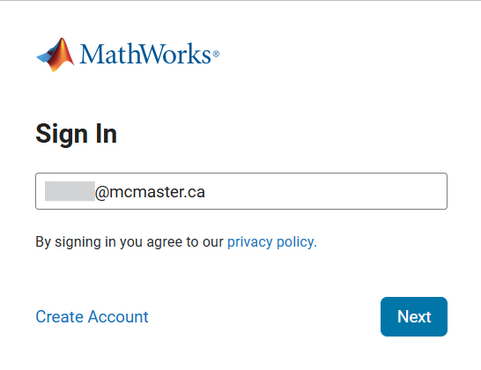
Installation Guide to MATLAB and Simulink R2025a
Installation Steps
Sign in to MathWorks Account by going to https://www.mathworks.com/.
Use the email address that is linked to the licence.
Notes:
MathWorks guide to install MATLAB: https://www.mathworks.com/help/install/ug/install-products-with-internet-connection.html

Slide 4
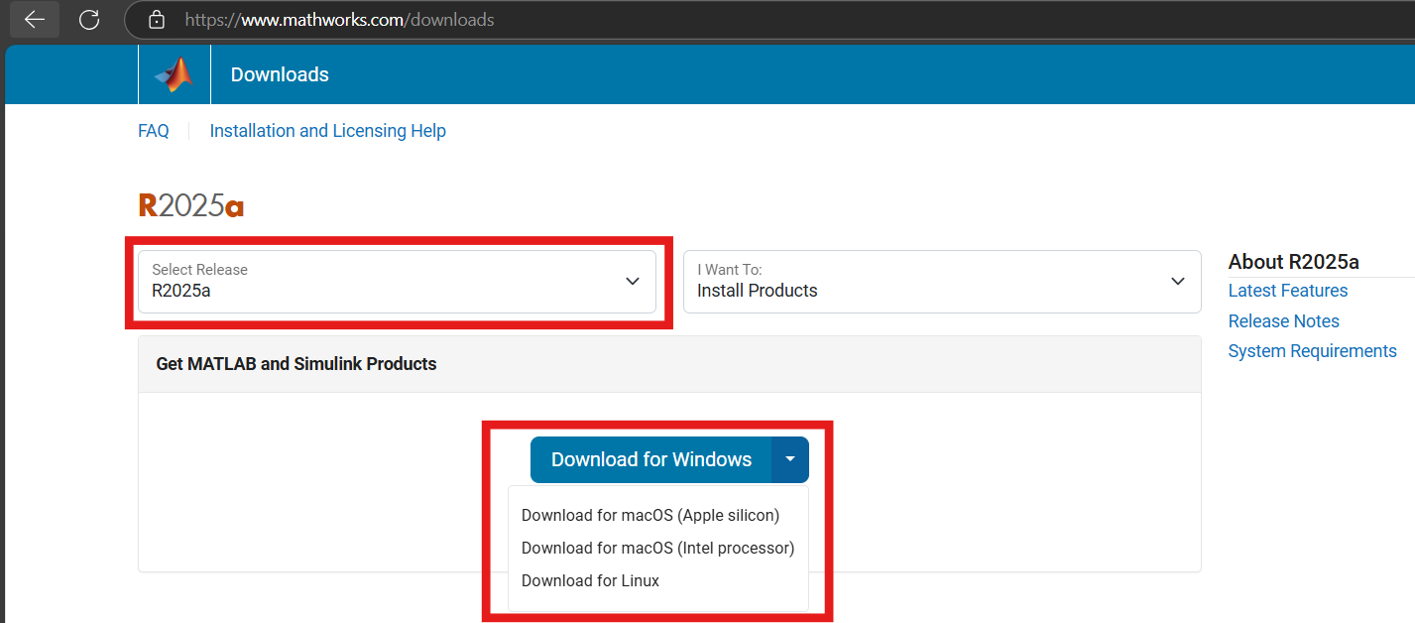
Installation Guide to MATLAB and Simulink R2025a
Installation Steps
3. Go to https://www.mathworks.com/downloads and choose the desired release.
4. Choose the OS platform compatible to your computer.
3
4
Notes:
MathWorks guide to install MATLAB: https://www.mathworks.com/help/install/ug/install-products-with-internet-connection.html

Slide 5
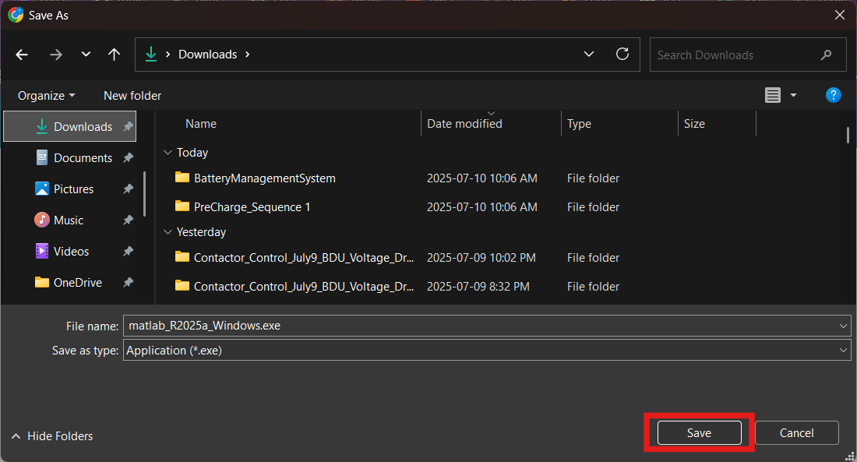
Installation Guide to MATLAB and Simulink R2025a
Installation Steps
5. Download the executable (.exe file).
Notes:
MathWorks guide to install MATLAB: https://www.mathworks.com/help/install/ug/install-products-with-internet-connection.html

Slide 6
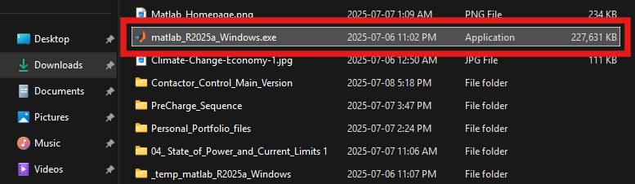
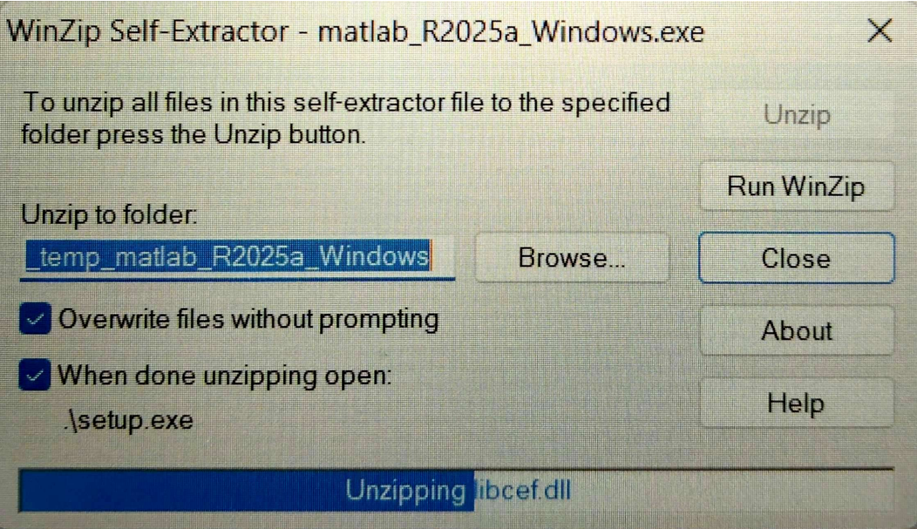
Installation Guide to MATLAB and Simulink R2025a
Installation Steps
6. After the download is completed, double-click the .exe file to unzip the file. It takes a few seconds to unzip.
Notes:
MathWorks guide to install MATLAB: https://www.mathworks.com/help/install/ug/install-products-with-internet-connection.html

Slide 7
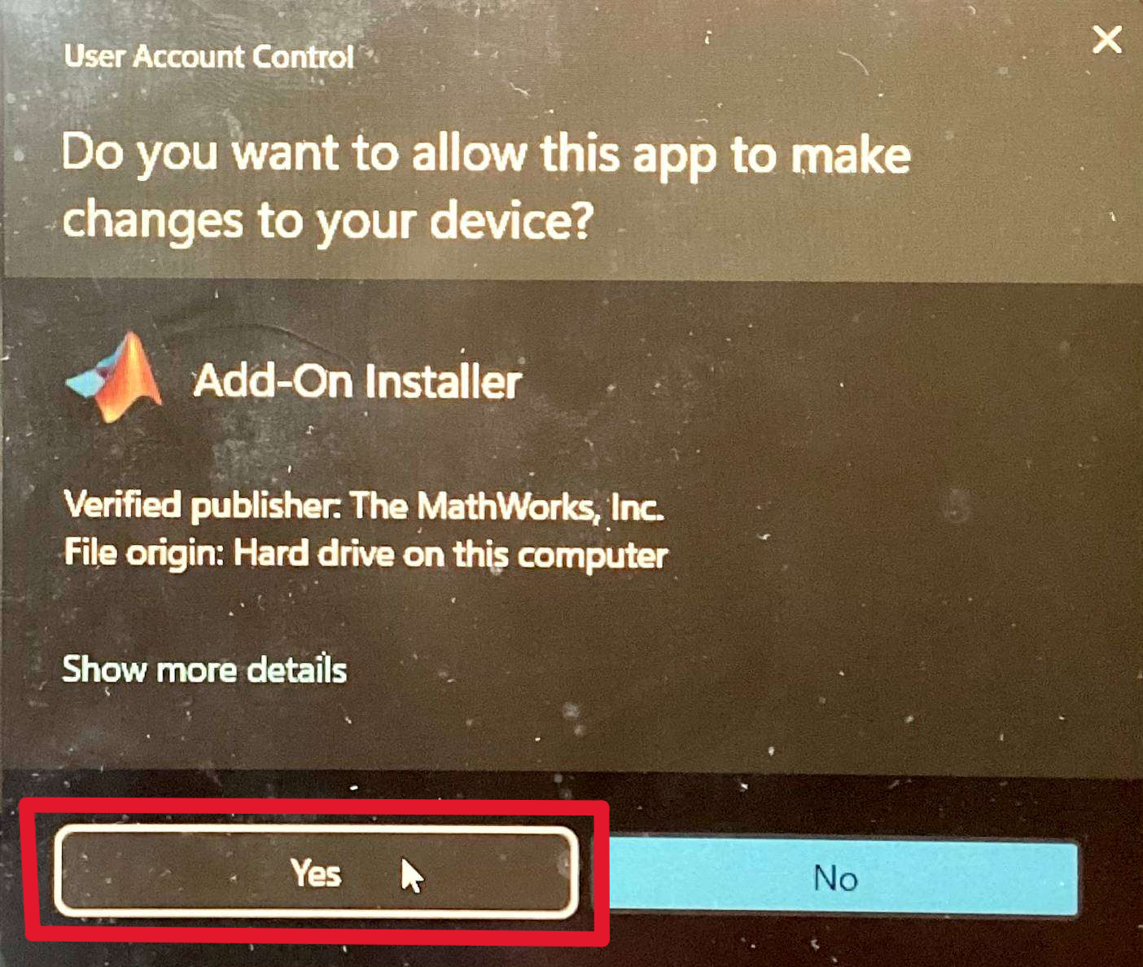
Installation Guide to MATLAB and Simulink R2025a
Installation Steps
7. In the pop-up window of “Do you want to allow this app to make changes to your device?”, press yes.
Notes:
MathWorks guide to install MATLAB: https://www.mathworks.com/help/install/ug/install-products-with-internet-connection.html

Slide 8
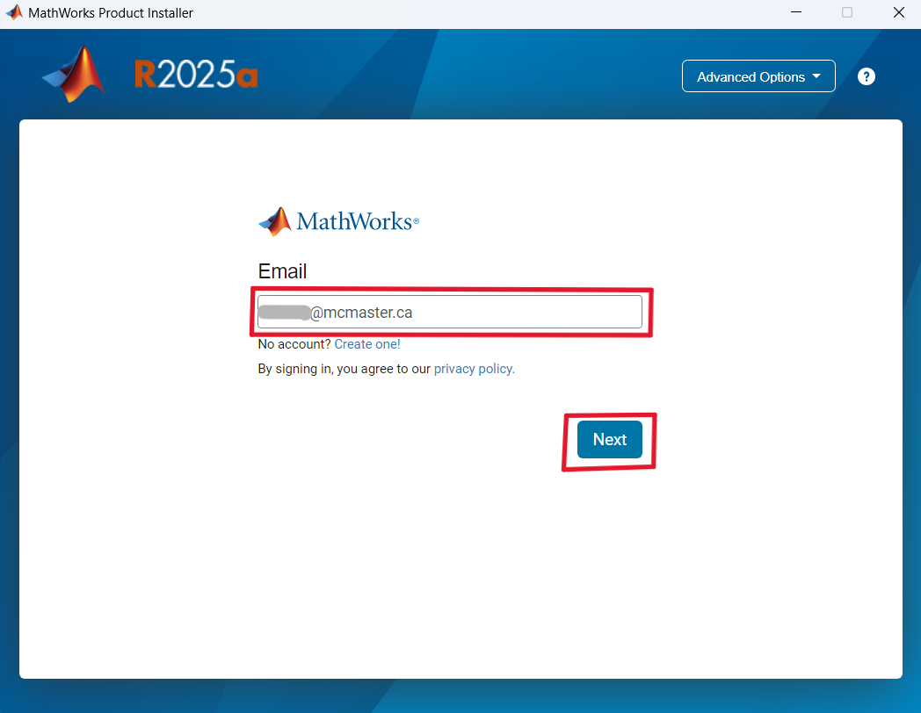
Installation Guide to MATLAB and Simulink R2025a
Installation Steps
8. In the MathWorks Product Installer pop-up window, enter the same email address and password that was used to sign in to MathWorks and press Next.
Notes:
MathWorks guide to install MATLAB: https://www.mathworks.com/help/install/ug/install-products-with-internet-connection.html

Slide 9
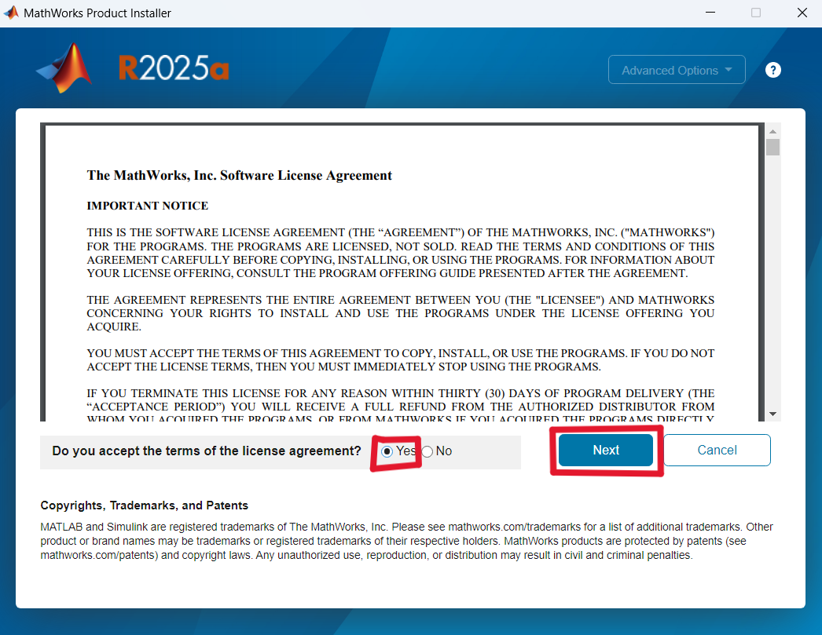
Installation Guide to MATLAB and Simulink R2025a
Installation Steps
9. Next, accept the terms of the licence agreement and press Next.
Notes:
MathWorks guide to install MATLAB: https://www.mathworks.com/help/install/ug/install-products-with-internet-connection.html

Slide 10
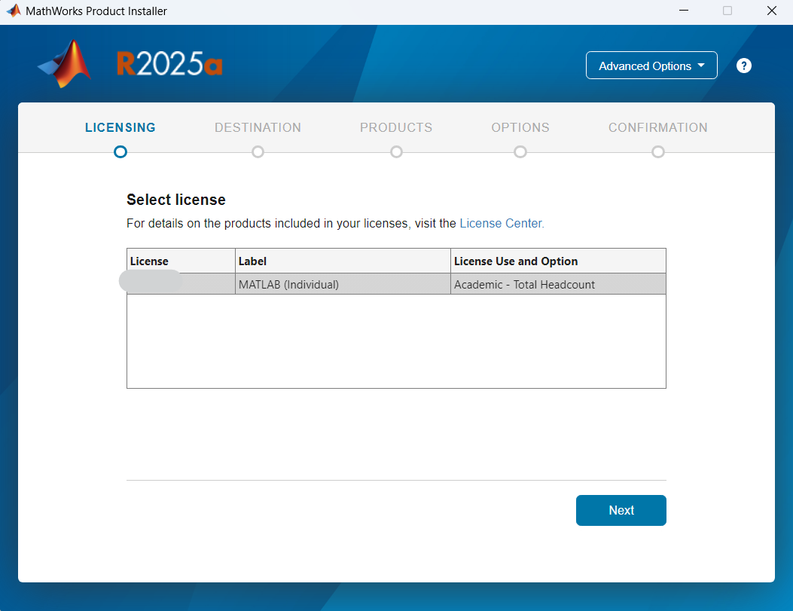
Installation Guide to MATLAB and Simulink R2025a
Installation Steps
10. In the Licensing tab, select the licence and press Next.
Notes:
MathWorks guide to install MATLAB: https://www.mathworks.com/help/install/ug/install-products-with-internet-connection.html

Slide 11
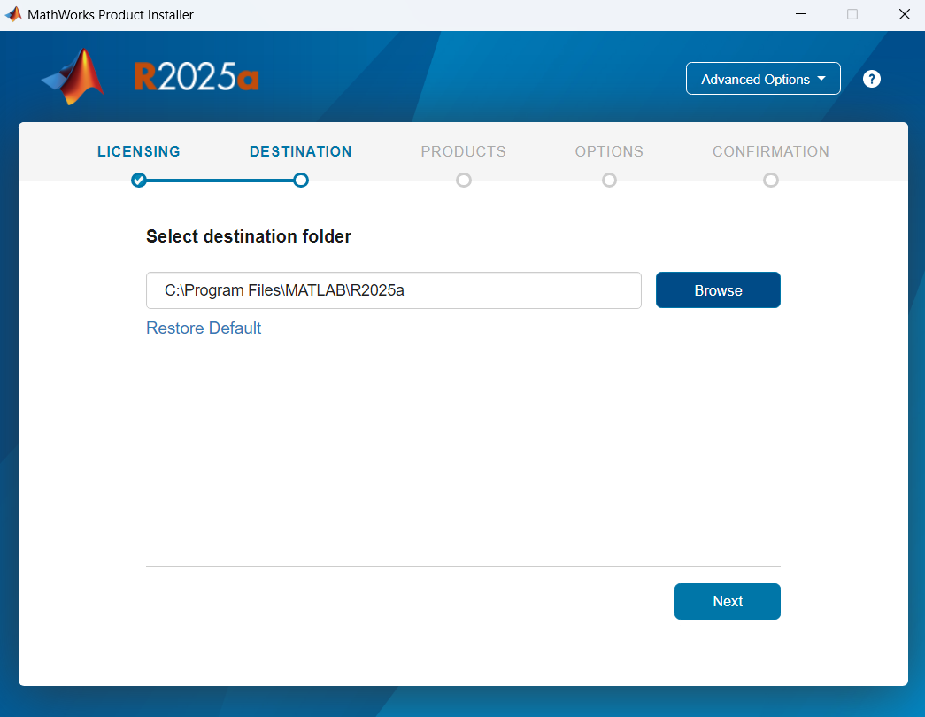
Installation Guide to MATLAB and Simulink R2025a
Installation Steps
11. In the Destination tab, type the directory where you want the main MATLAB software and its associated files to be located. If not sure, keep the default installation directory and press Next.
Notes:
MathWorks guide to install MATLAB: https://www.mathworks.com/help/install/ug/install-products-with-internet-connection.html

Slide 12
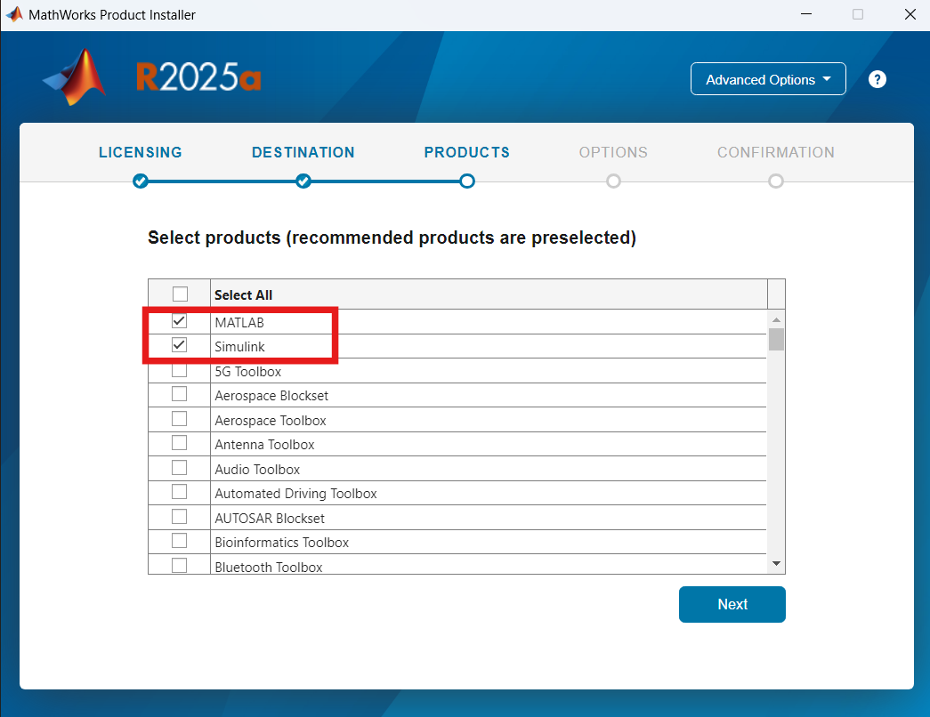
Installation Guide to MATLAB and Simulink R2025a
Installation Steps
12. In the Products tab, select the products you want to install and press Next.
Note: If you have enough memory space in your computer, it is recommended that you install all products together by checking off Select All. This way, you don’t have to manually install each Add-on authored by MathWorks.
Notes:
MathWorks guide to install MATLAB: https://www.mathworks.com/help/install/ug/install-products-with-internet-connection.html

Slide 13
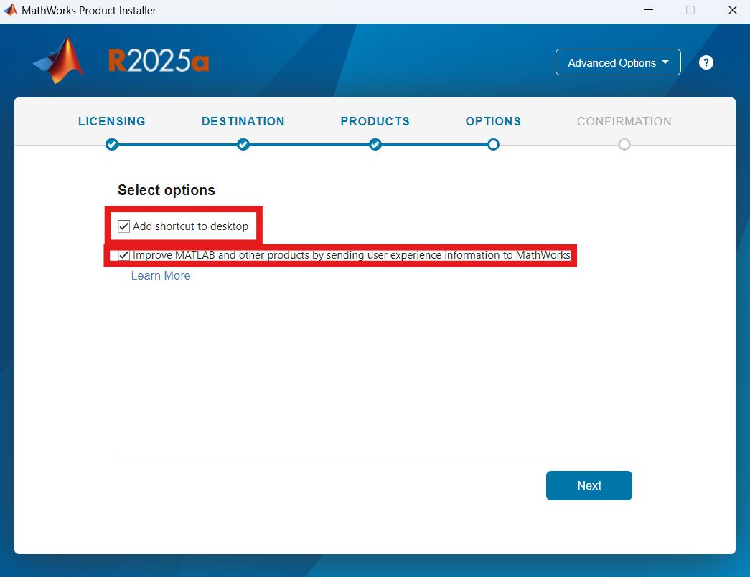
Installation Guide to MATLAB and Simulink R2025a
Installation Steps
13. In the Options tab, select the item(s) based on your preferences and press Next.
Notes:
MathWorks guide to install MATLAB: https://www.mathworks.com/help/install/ug/install-products-with-internet-connection.html

Slide 14
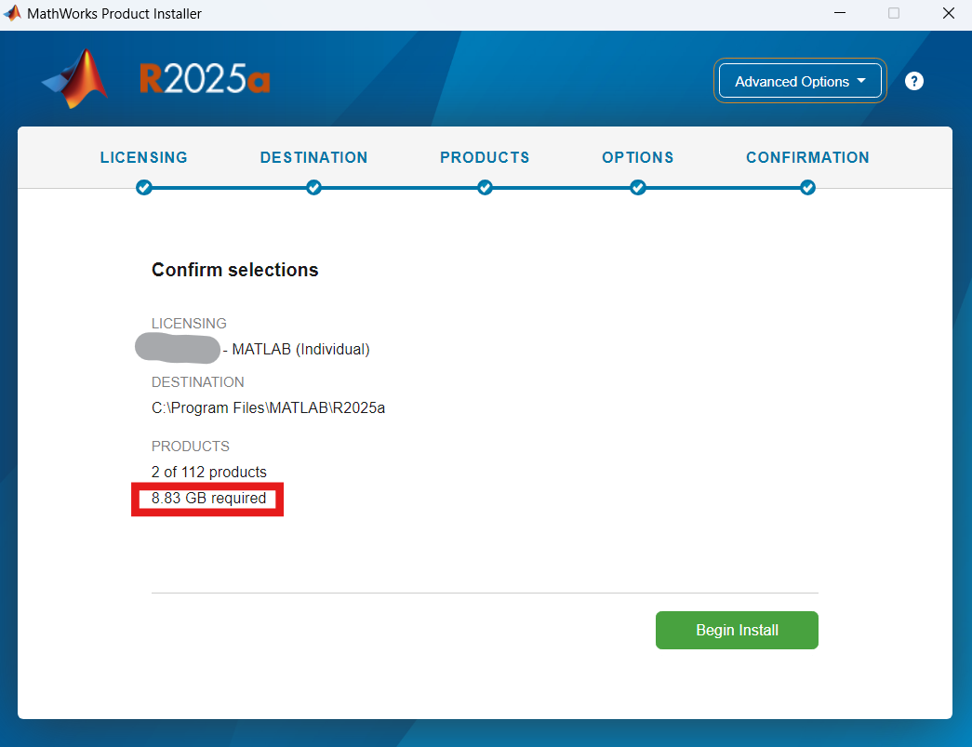
Installation Guide to MATLAB and Simulink R2025a
Installation Steps
14. In the Confirmation tab, press Begin Install. Make sure you have the required storage space.
Notes:
MathWorks guide to install MATLAB: https://www.mathworks.com/help/install/ug/install-products-with-internet-connection.html

Slide 15
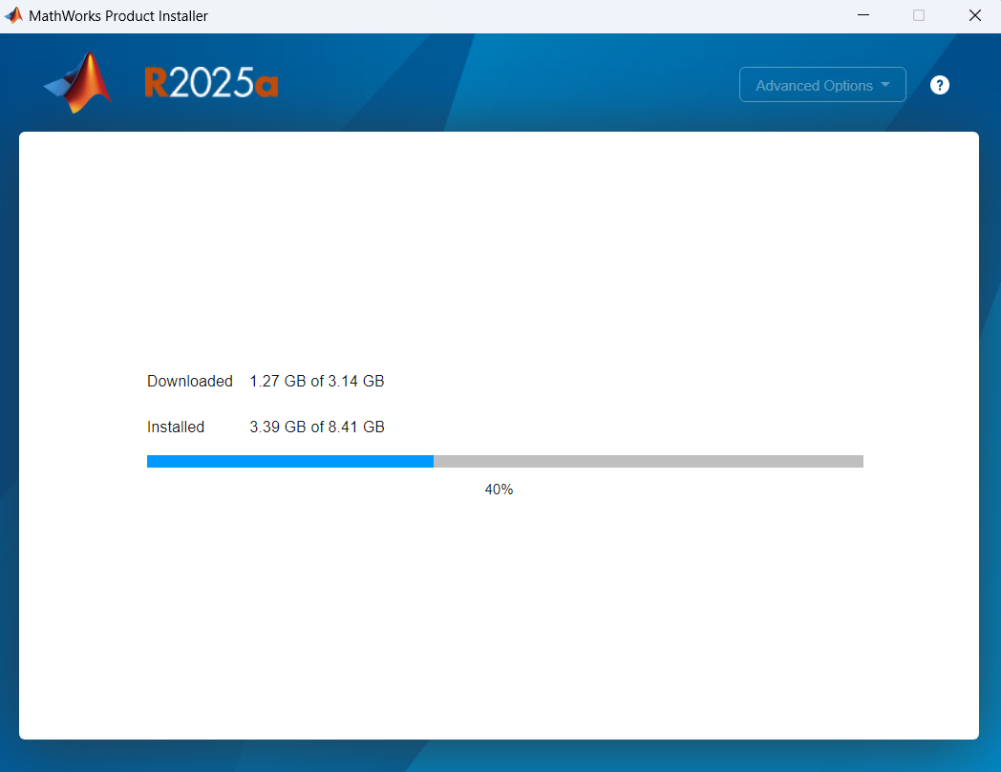
Installation Guide to MATLAB and Simulink R2025a
Installation Steps
15. It might take a few minutes (i.e., 10-20 minutes) to complete the download and the installation of MATLAB and Simulink.
The download speed depends on internet connection speed, MATLAB version and toolboxes selected, etc.
The installation speed depends on CPU, RAM, storage disk type and speed, the number of products selected, etc.
Notes:
MathWorks guide to install MATLAB: https://www.mathworks.com/help/install/ug/install-products-with-internet-connection.html

Slide 16
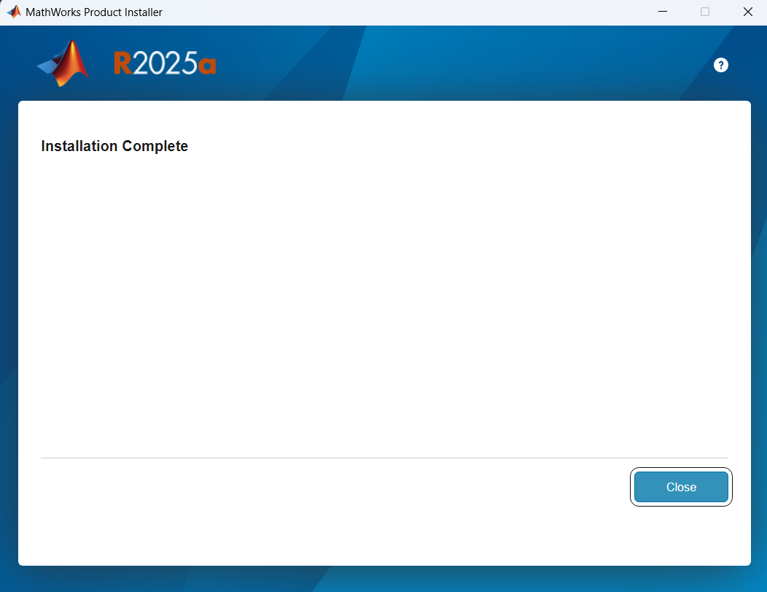
Installation Guide to MATLAB and Simulink R2025a
Installation Steps
16. Once the installation is complete, close the Installer by pressing Close.
Notes:
MathWorks guide to install MATLAB: https://www.mathworks.com/help/install/ug/install-products-with-internet-connection.html

Slide 17
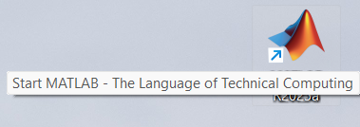
Installation Guide to MATLAB and Simulink R2025a
Installation Steps
17. If previously “Add Shortcut as Desktop” was selected, a MATLAB icon should show up on the desktop.
Alternatively, click the Start button and search for MATLAB.
Launch the MATLAB desktop application by double-clicking the MATLAB icon.
Notes:
MathWorks guide to install MATLAB: https://www.mathworks.com/help/install/ug/install-products-with-internet-connection.html

Slide 18
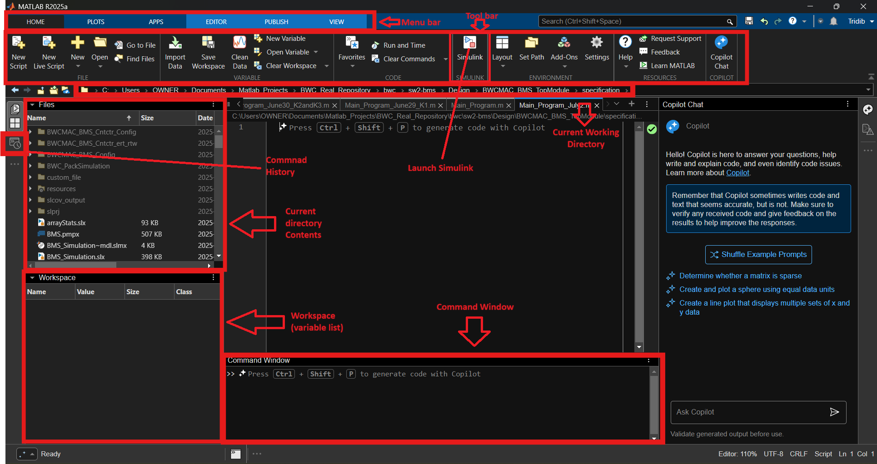
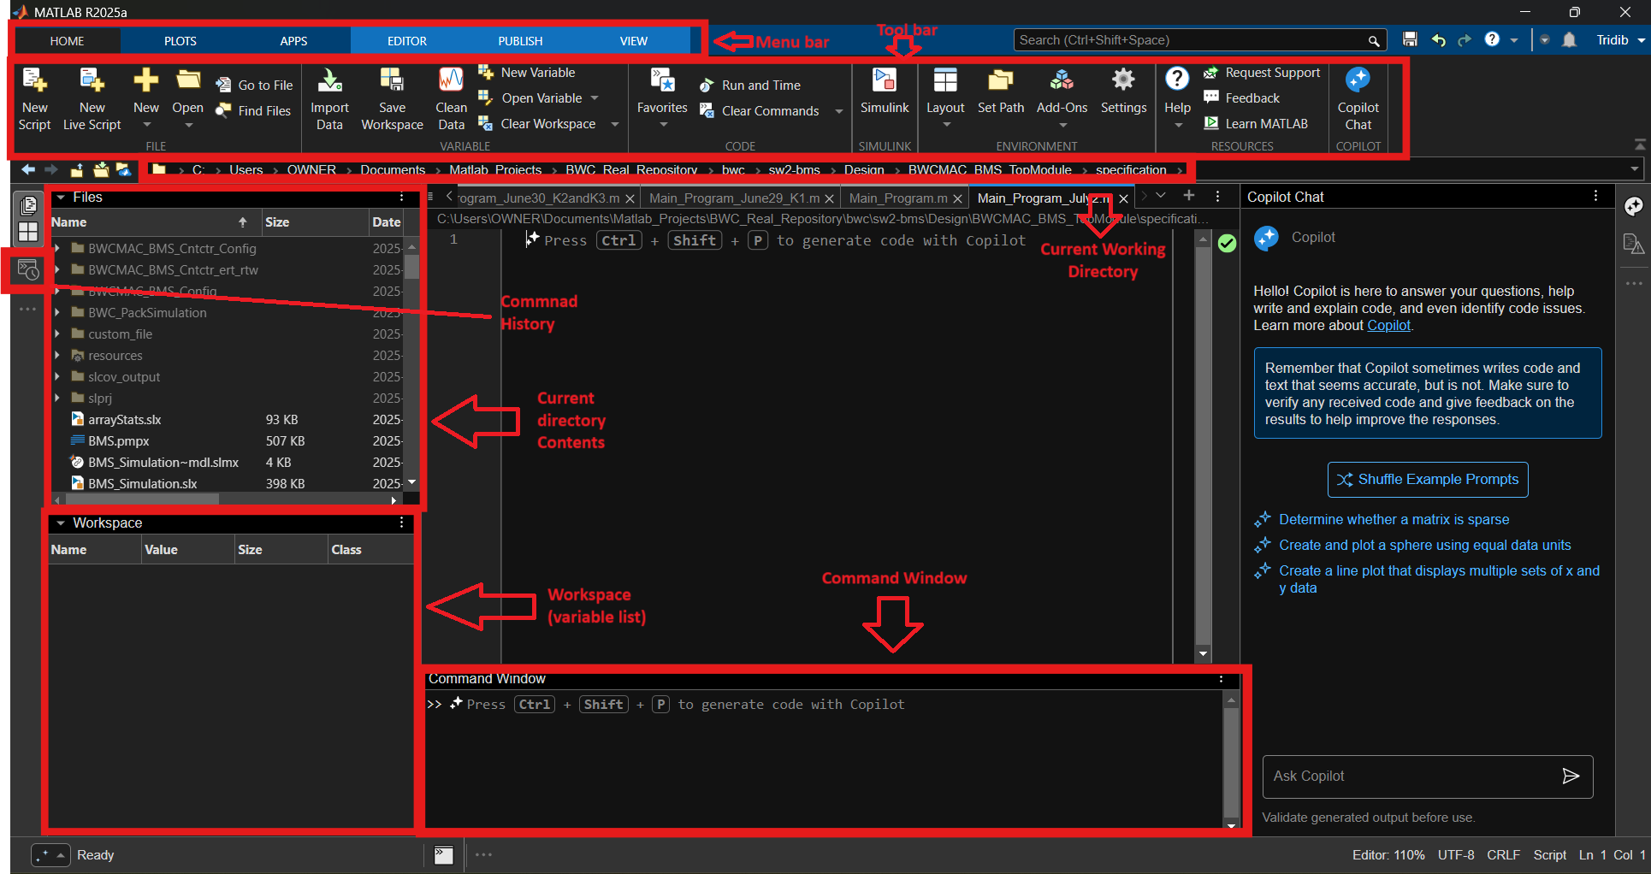
Installation Guide to MATLAB R2025a
Installation Steps
11. MATLAB 2025a version’s homepage looks like this.
Notes:
MathWorks guide to install MATLAB: https://www.mathworks.com/help/install/ug/install-products-with-internet-connection.html

Slide 19
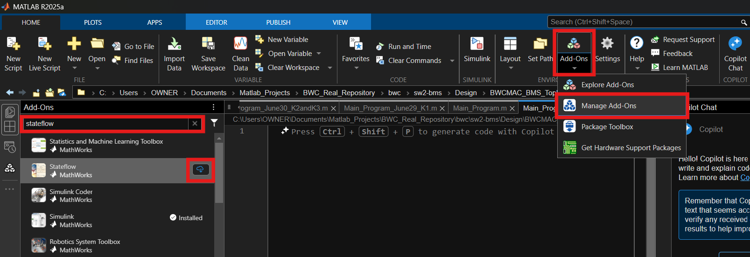
Installation Guide to MATLAB and Simulink R2025a
Installation Steps
18. To install an add-on (i.e., Stateflow), form the Add-Ons dropdown, press Manage Add-Ons and search for the desired add-on and install it by pressing the install icon on the right side.
Notes:
MathWorks guide to install MATLAB: https://www.mathworks.com/help/install/ug/install-products-with-internet-connection.html

Slide 20
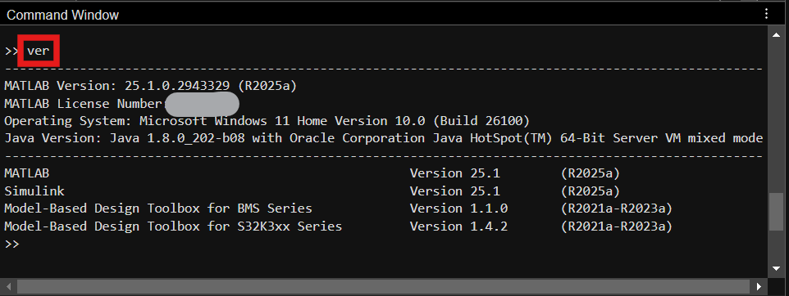
Installation Guide to MATLAB and Simulink R2025a
Installation Steps
19. To view what add-ons are already installed on your computer, type ver in the Command Window and press Enter.
Notes:
MathWorks guide to install MATLAB: https://www.mathworks.com/help/install/ug/install-products-with-internet-connection.html

Slide 21
Thank you
McMaster Automotive Resource Centre (MARC)
21

